Slide 1

GenderRecognition by voice
Developer : Krishna
Dataset : https://raw.githubusercontent.com/insaid2018/Term-3/master/Projects/gender_recognition_by_voice.csv

Slide 2
What?
Use acuostic characteristics(mean frequency & skew etc.) to determine the gender of the person.
Compare different kernel methods.
Do Prediction.
Why?
Gender Recognition is a key part of identification.
The Results of gender recognition can be used in many other fields.
Knowledge about acoustic characteristics is very helpful to process and restore data informaton.

Slide 3
Acoustic characteristics
Mean frequency
Standard deviation
Median frequency
First quantile
Third quantile
Interquantile range
Skewness
Kurtosis
Spectral entropy
Spectral flatness
Mode frequency
Frequency centroid
meanfun
Minfun
Maxfun
Meandom
Mindom
Maxdom
Dfrange
Modindex

Slide 4
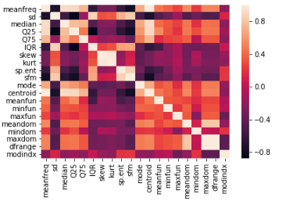
In the image, we see that correlation between centroid and meanfreq is high. And,Correlation between maxdom and dfrange is high. So, I had dropped that two columns for better accuracy.
Correlation between features

Slide 5
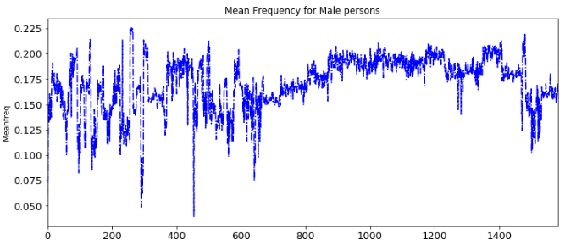
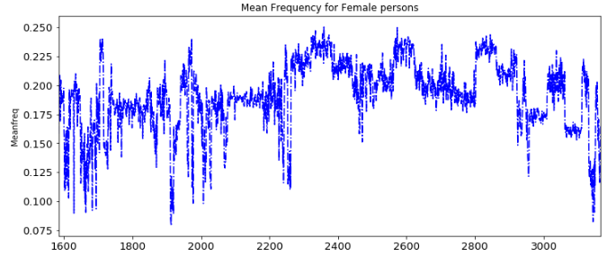
Meanfrequency of Male and Female

Slide 6
Comparision between Linear, RBF and Polynomial kernel types :
Linear kernel type :
Accuracy Score : 0.9779179810725552
RBF kernel type :
Accuracy Score:
0.9779179810725552
Polynomial kernel type :
Accuracy Score :
0.9652996845425867
We can observe the accuracy scores of different types of kernels as linear and RBF accuracy scores are almost equal. And Polynomial accuracy score is less compared with other two types. So, We can use Linear or RBF for model for better performance.

